Slide 1
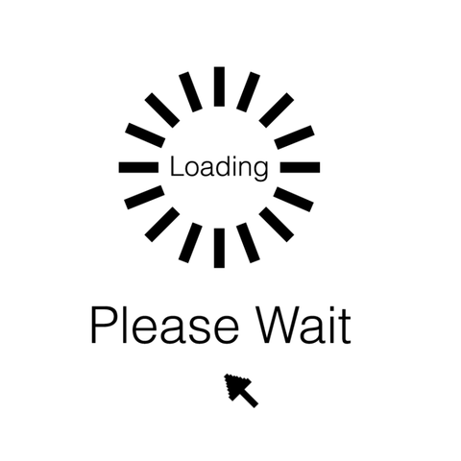
Baptist Health DevOps Terraform Workshop
Day 1 – Introduction to DevOps, VS Code and Terraform

Slide 2

Hello!
Jordan Baldridge
Senior Software Engineer, Insight

Slide 3
This Week’s Schedule
Day 1 – Introduction to DevOps, VS Code and Terraform
Day 2 – Introduction to GitHub & Terraform Cloud
Day 3 – Advanced Terraform and BHS Terraform

Slide 4
DevOps Overview
Notes:
Take a look at this slide title – ‘ How you operate’ - kill the sub title?

Slide 5

Agile Values
Individuals and Interactions
Working Software
Customer Collaboration
Responding to Change
Processes and Tools
Comprehensive Documentation
Contract Negotiation
Following a Plan
That is, while there is value in the items on the right, we value the items on the left more.
Notes:
Todd
OBJECTIVE: Provide a high level background and understanding of the manifesto for agile software delivery origins. It's about a culture shift not a method or framework
Story of Agile
In the 1990’s, there were a number of thought leaders in the software development industry who were independently experimenting on better ways to deliver value. They were frustrated by how badly we have done at delivering quality, useful products in a timely fashion (you can refer to the Standish reports for evidence that we, as an industry, are BAD at this).
They recognized that software development is highly complex and, thus, is very hard to predict. Everything we do is custom, not exactly like anything we have done before. Also, our requirements are often unclear and, even if they were actually all known up-front, change before we deliver the software. On top of this, our technology is very complex and is constantly changing – the layers of complexity are truly impressive.
They realized that we have been trying to manage our software development activities as if we were building a car. As complicated as it is to build a car, once you have done it a few times, it is repeatable with a small amount of variance. But everything we build in software is custom, and our environment is highly complex and dynamic, which makes it inherently unpredictable. Why are we trying to manage a dynamic, complex situation as if it was a steady, repeatable activity?
2001, seventeen people met to talk, ski, relax, and try to find common ground—and of course, to eat. What emerged was the Agile ‘Software Development’ Manifesto. Representatives from multiple disciplines all sharing a sympathy to the need for an alternative to documentation driven, heavyweight software development processes convened.
We are uncovering better ways of developing software by doing it and helping others do it
But while the Manifesto provides some specific ideas, there is a deeper theme that drives many, but not all of the attendees. Many felt privileged to work with a group of people who held a set of compatible values, a set of values based on trust and respect for each other and promoting organizational models based on people, collaboration, and building the types of organizational communities in which we would want to work; focused on delivering good products to customers by operating in an environment that does more than talk about "people as our most important asset" but actually "acts" as if people were the most important, and lose the word "asset".
The Agile movement is not anti-methodology, in fact, many of us want to restore credibility to the word methodology. We want to restore a balance. We embrace modeling, but not in order to file some diagram in a dusty corporate repository. We embrace documentation, but not hundreds of pages of never-maintained and rarely-used tomes. We plan, but recognize the limits of planning in a turbulent environment.
Agility is a culture shift – from business to operations, from processes to people

Slide 6
Agile Principles
Our highest priority is to satisfy the customer through early and continuous delivery of valuable software. | Working software is the primary measure of progress.
Welcome changing requirements, even late in development. Agile processes harness change for the customer's competitive advantage. | Agile processes promote sustainable development. The sponsors, developers, and users should be able to maintain a constant pace indefinitely.
Deliver working software frequently, from a couple of weeks to a couple of months, with a preference to the shorter timescale. | Continuous attention to technical excellence and good design enhances agility.
Business people and developers must work together daily throughout the project. | Simplicity--the art of maximizing the amount of work not done--is essential.
Build projects around motivated individuals. Give them the environment and support they need, and trust them to get the job done. | The best architectures, requirements, and designs emerge from self-organizing teams.
The most efficient and effective method of conveying information to and within a development team is face-to-face conversation. | At regular intervals, the team reflects on how to become more effective, then tunes and adjusts its behavior accordingly.
Notes:
Can we automate these to come in one at a time so they are not overwhelmed all at once? Then I think the transition to the next slide is you pointing out that is a lot to absorb. Let’s make it simple..
TODD
Objective between this and next slide is to communicate the core of the values. This slide is meant to show the actual principles. The next slide is meant to show the values more simply for what they really are, the importance and value.
Here we see the 12 Principles of Agile which we will view. As you can see, this is a lot to absorb, so let’s make it simple

Slide 7
Agile Principles
Build high-functioning, cross-functional, self-organizing teams
Deliver working increments of product early and often
Focus on highest value first
Reduce waste & increase simplicity
Respond to change
Iterate & continuously improve
Notes:
TODD
The first principle empowers delivery of working software by having effective, collaborative teams that are able to address the needs of the customer. Businesspeople and engineers must work together daily throughout the project and have trust, allowing engineers to do what they do best
The second principle supports the delivery of working software by producing more, earlier and often. This ensures that instead of waiting for a monolithic project to complete from negotiation to planning and start to finish, we are able to deliver value more frequently and earlier.
Focusing on the highest value first ensures we are addressing the most important needs of a project so we can deliver more and quicker for the most value possible.
Reduce waste and increase simplicity – maximize how much work is NOT done
Respond to change – this, to me, is the most important value for Agile. While we all make plans to match our goals, we all know that situations change – whether that be new requirements (technical, financial, legal), new goals, etc, we must be able to respond. When I think of being Agile and one of the constants of DevOps – and development in general – I think of change and response to change. By being agile, we are able to respond to changes earlier and quicker instead of waiting until the finish line to learn that we have to redo our work
Iterate and continuously approve – by iterating – or breaking down our work into “Sprints” or “Chunks”, we are able to perform planning, developing, testing, QA and deployment/delivery earlier and quicker. This allows us to respond to changes and continuously improve – not just in software, but our processes and behaviors. By having shorter iterations, we can address our needs, successes and failures earlier and quicker and improve in any area that otherwise may be ignored

Slide 8



Achieving A Complex Goal
Linear
Predictive
“
B
A
Sequential
Deliver
The only way it's all going to go as planned is if you don't learn anything along the way
Plan
Empirical: based on, concerned with, or
verifiable by observation or experience
rather than theory or pure logic
Discovery
Development
Hardening
Empirical
F
B
D
E
A
H
G
B
Deliver
C
Iterative & Incremental
Plan
© Insight Digital Innovation
Notes:
**This slide is layered and animated, change with caution**
Slide Intent:
This slide points out that we can’t predict how a complex goal or task will be accomplished. All we can do is iteratively plan and incrementally deliver so that we can better understand what should be done next based on the feedback we continuously receive from our stakeholders and customer base.
Talking Points:
Predictive lines – (linear line) “Tradition will tell us that if we need to get from point A to point B… we create a plan to get here, and that plan would represent the steps to accomplish the goal or task. This assumes your work is in the “Simple” bucket, where you can plan, execute, and deliver the outcome with no change or emergent work. (Sequential section) The requirements and plan are created upfront and delivery to the customer happens once all the planned work has been completed. (Squirrely line) But most of our work is complex, so if we look back at the end we’d probably see a line more like “this” because as we worked, things changed… customer needs, technology, the people involved, the company was sold to a competitor… could be many reasons, but we had to respond regardless.”
Empirical Lines – “So instead, when we want to accomplish a complex goal, we use empiricism (show definition) to harness the fact that things change often. So when our work is complex and need to get from point A to point B we iterate over the plan, we incrementally deliver, and we get continuous feedback from our stakeholders/customers to make sure we’re achieving their current needs. We accept that the line is not straight, and no amount of predictive planning can make the line straighter. We must build something small, but significant to the customer, so that we can inspect and adapt our progress along the way. This is how we reduce the risk of delivering complex work.”

Slide 9
So what is DevOps then?
So what is DevOps?
DevOps is the combination of cultural philosophies, practices, and tools that increases an organization’s ability to deliver applications and services at high velocity: evolving and improving products at a faster pace than organizations using traditional software development and infrastructure management processes. This speed enables organizations to better serve their customers and compete more effectively in the market.

Slide 10
DevOps Simplified:
The union of people, process and products to enable continuous delivery of value to our end users

Slide 11
Benefits of DevOps
Break down “siloes”
Create integrated teams where engineers work across software lifecycle, from development to operations
use practices to automate processes that historically have been manual and slow.
They use a technology stack and tooling which help them operate and evolve applications quickly and reliably. These tools also help engineers independently accomplish tasks

Slide 12
More Benefits of DevOps
Speed
Rapid delivery
Reliability
Scale
Improved Collaboration
Security
Notes:
Speed: innovate, adapt, and grow more efficient faster
Rapid delivery: increase frequency and pace of delivery. The faster you can deliver, the faster you can respond to needs
Reliability: Ensure the quality of updates and changes in apps and infrastructure and maintain a positive experience for customers
Scale: operate and manage at scale to meet needs ; automation helps reduce complexity and risk
Improved Collaboration: Build more effective teams with responsibility and accountability. Collaborate closely, share responsibilities and create better workflows to reduce inefficiencies
Security: move and deliver quicker while maintaining control and compliance

Slide 13
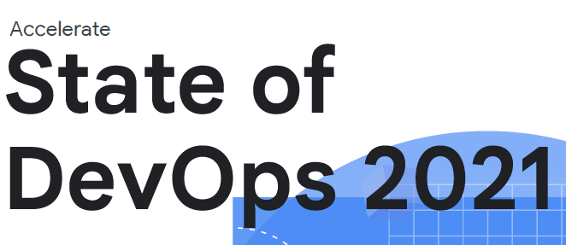
Software Delivery and Operational Performance
Deployment Frequency
Lead Time to Change
Change Failure Rate
Time to Restore Service
Source: Google. (Accessed November 2021). Accelerate State of DevOps 2021; Smith, Villalba, et al https://services.google.com/fh/files/misc/state-of-devops-2021.pdf
Notes:
High performing orgs measured on 4 criteria:
1. Deployment frequency (on demand)
2. Lead time for changes (<1 day)
3. Change failure rate (0-15%)
4. Mean time to restore (<1 hour)
Accelerate State of DevOps annual report released in August MULTICLOUD
Multi-cloud usage is up year-over-year amongst all respondents surveyed for the 2019 Accelerate State of DevOps report
Fueled by availability, performance gains, flexibility, and acquisitions
TOOLS
The highest performing engineers are 1.5x more likely to have easy-to-use tools
Proprietary tools are concentrated in the lowest performing orgs while the opposite is seen in the highest performing orgs
Tools with better usability and utility are more likely to be adopted and used by teams
TEAMS
High performance teams are empowered to pick their own toolchains
Teams self organize into communities of practice in order to share ideas in a supportive and safe place
AUTOMATION
Automation gives teams confidence, which reduces stress in pushing changes
Automating manual work frees up engineering time to help with feature work which in turn delivers more value to customers

Slide 14
Azure Overview
A high-level tour of a massive cloud platform

Slide 15
Why do we automate?
Notes:
First, we have to ask, why do we automate?
Scalability and agility – save time, money, handle issues, needs and experimentation quicker and more efficiently, and foster continuous learning and innovation
Reduce complexities and cost
Eliminate errors and risks
More time for higher-value tasks
Streamline processes
Control and compliance
Integrate and deploy without downtime
Keep pace with infrastructure scale
Create team-based solutions that work across technologies
Accomplish processes that can’t (or shouldn’t) be done manually

Slide 16
What is the cloud?
“Cloud computing is a model for enabling ubiquitous, convenient, on-demand network access to a shared pool of configurable computing resources (e.g., networks, servers, storage, applications, and services) that can be rapidly provisioned and released with minimal management effort or service provider interaction.” -- National Institute of Standards and Technology Special Publication 800-145, September 2011

Slide 17
Cloud Characteristics
As defined by the National Institute of Standards and Technology*
On-demand self-service
Rapid elasticity
Measured service
Resource pooling
Broad network access
* See NIST Special Publication 800-145
Notes:
NIST's mission
To promote U.S. innovation and industrial competitiveness by advancing measurement science, standards, and technology in ways that enhance economic security and improve our quality of life.

Slide 18
Cloud Service Models
Software-as-a-Service (SaaS)*
Platform-as-a-Service (PaaS)*
Infrastructure-as-a-Service (IaaS)*
* See NIST Special Publication 800-145
Notes:
NIST's mission
To promote U.S. innovation and industrial competitiveness by advancing measurement science, standards, and technology in ways that enhance economic security and improve our quality of life.

Slide 19
Cloud Deployment Models
Public Cloud*
Private Cloud*
Hybrid Cloud*
Community Cloud*
* See NIST Special Publication 800-145
Notes:
NIST's mission
To promote U.S. innovation and industrial competitiveness by advancing measurement science, standards, and technology in ways that enhance economic security and improve our quality of life.
Public Cloud: cloud services and offered by 3rd-parties like AWS, Azure, GCP, IBM over the public Internet, making them available to anyone
Private Cloud: a private “cloud” within an organization. computing services offered either over the Internet or a private internal network and only to select users instead of the general public.
Hybrid Cloud: like BHS, a hybrid of public cloud and private cloud:
a mixed computing environment where applications are run using a combination of computing, storage, and services in different environments—public clouds and private clouds, including on-premises data centers or “edge” locations
Community Cloud: cloud shared by several oragnizations from a community with common concerns, whether that be security, compliance, jurisdiction, etc

Slide 20
Patterns & Challenges
IT in 2023
IT is in the midst of a generational transition
Customers demand more value more quickly
Digital Transformation is a priority to business
IT is shifting from a cost center to a strategic differentiator
The Cloud underpins digital transformation
Full featured APIs/SDKs
Pay-as-you-go and on-demand
Near limitless scale (public cloud)
Automation is hard but necessary to operate at scale
Shift security left
Integrate IT Operations
Infrastructure managed declaratively as code
Notes:
83% of IT decision makers say increasing IT operational efficiency is a top priority (2018 Mulesoft Connectivity Benchmark Report)
Automation is key to demands and needs
Cloud underpins transformation with different payment models and near limitless scalability
Automation is

Slide 21
The Cloud Dictionary
IaaS, PaaS,
SaaS & CaaS
Horizontal / vertical scaling
Public, hybrid & private cloud
Lift & shift²
SLAs
Notes:
NIST document references all of these

Slide 22
The Cloud Advantages
Cost
Agility
Flexibility
Scalability
Reliability
Notes:
Costs - Easily the biggest advantage of cloud computing is that it significantly cuts your overhead. Let’s say you want to set up an on-premises network. It’s not just the servers that cost money. You’ll also need a special room to house them, electricity, and someone to keep an eye on things. In comparison, a cloud server is 79% cheaper to run. This is because the cloud provider handles utilities, maintenance, and other overhead costs. Meanwhile, you pay for only what you need. So if you need storage, for instance, you can pay by the gigabyte instead of having to fork out the price of a whole server.
Flexibility - The subscription model means you can easily adjust cloud computing services to suit your needs. Just starting out? Many SaaS, PaaS, and IaaS providers have free plans, so you can keep costs down. Once you start growing, you can upgrade to a paid subscription in minutes. The same goes if you have a temporary spike in demand. Let’s say you’re running a sale and need extra bandwidth. There’s no need to buy a new server. Upgrade your plan, and downgrade again when the sale is over.
Reliability - Most cloud service providers assure guaranteed assistance round the clock. When you opt for cloud computing, all the service-related technicalities are taken care of by the cloud service provider. In the case of a disaster, even if the host server fails, the data can easily be transitioned to other available servers. The cloud service providers abide by the signed Service Level Agreements (SLAs) to ensure timely assistance to your business needs.

Slide 23





ORGANIZATION
ACTIVE DIRECTORY TENANT
SUBSCRIPTIONS
ACCOUNTS
Notes:
Hierarchy of Azure
This is a top-level component. This is also known as Azure Tenant or Azure Active Directory. There can be more than one tenant associated with an account. This is the placeholder for all other component of Azure. This is just a logical boundary. Every tenant has one id associated with it, and at least one domain. This is where we can manage all the users, groups who wants to access the tenant. At this level, highest possible role is GLOBAL ADMINISTRATOR
This comes under a tenant. Every tenant has at least one subscription associated with it. We can have more than one subscription. This is where all resource groups( we will discuss this in the next section ) are managed. This is also just a logical boundary around resource groups. Every subscription has one Id associated with it. User inherits their role from tenant, and if we want to modify the capabilities of user at this level, then we can only increase it, but not decrease it.
Organize your cloud-based resources to secure, manage, and track costs that are related to your workloads. To organize your resources, define a management group hierarchy, consider and follow a naming convention, and apply resource tagging.

Slide 24
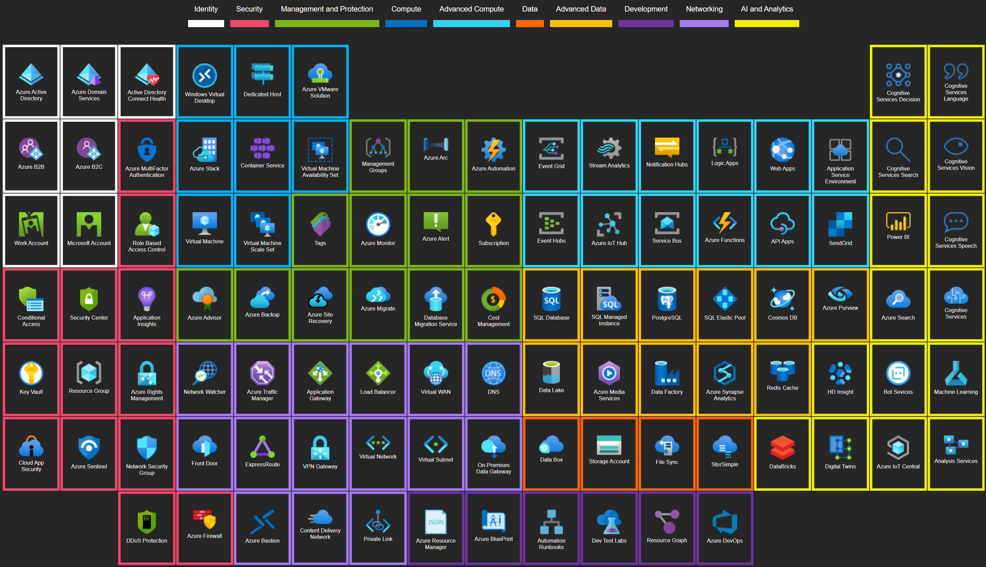
https://azureperiodic.data3.com/

Slide 25
Organizational Concepts
Organizing Your Resources
Management Groups
Subscriptions
Resource Groups
Resource Groups
Subscriptions
Resource Groups
Resources
Resources
Resources
Resources

Slide 26
Organizational Concepts
Management Groups
Root Management Group
Human Resources
Dev/Test Subscription
Apps
IT
Production
Region 1
Region 2
Prod Hub
Prod Spoke 1
Marketing
Trial Subscription
Prod Spoke 2
EA Subscription
Notes:
Governance (Shoot to Jordan)
Policies

Slide 27
Lab 1: Azure Initial setup
Create a Free Azure Account
https://azure.microsoft.com/en-us/free/
Create a Service Principal (SPN) for Automation

Slide 28
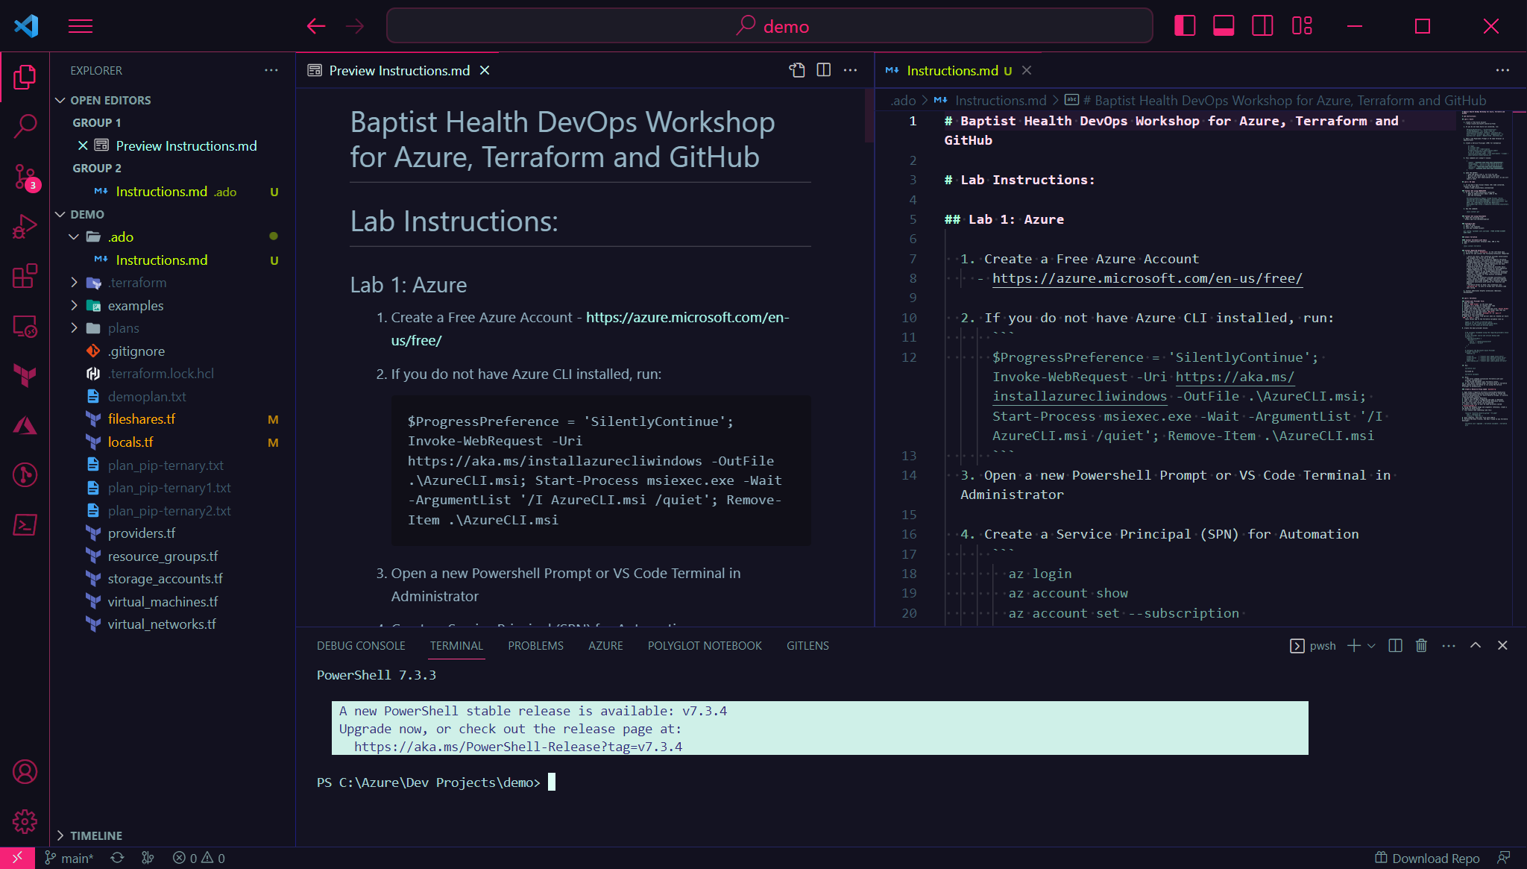
VS Code

